Slide 1
The Agents’Domain
The Agents' Domain (AI Comprehensive Application Platform)
Proposal for an AI-based Human-Computer Collaborative Work Management System.
2024.02.17
Reporter：SOB

Slide 2
Directory
System Overview
Core Platform of The Agents
Software Generation and Management Platform
Customer Application Platform
User Management Platform
Workflow Management Platform
Payment Management Platform
Portal Website of The Agents' Domain
Application management System
Reference System
Analysis System and Algorithm

Slide 3
01
System Overview
System Overview.

Slide 4


Requirement
In the era of AGI (Artificial General Intelligence), the main theme is mutual learning and progress between humans and artificial intelligence (AI). The system aims to create an environment where humans and AI agents work together. It is designed to facilitate collaborative work by generating various applications through AI to assist humans in completing tasks. The system also provides necessary resources like capital and labor to AI agents, fostering internal collaboration and adaptive development within the AI ecosystem.
VIEW MORE

Slide 5
System Struct
Core Platform of The Agents Developed collaboratively by a team of developers and experts, this system has the capacity for automatic development, deep domain knowledge, and continuous learning and improvement. In the realm of The Agents, each agent evolves autonomously, works collaboratively, and completes tasks assigned by other platforms.
Software Generation and Management Platform Maintained by the development and management team, this professional software generation platform allows managers to provide the realm of The Agents with knowledge bases and system requirements. The realm provides the software generation platform with information in UADL (Universal Application Description Language), which developers use to generate and update systems using templates.
Customer Application Platform Responsible for collecting and managing customer information, forming tasks that can be completed by specific agents. After an agent within the realm of The Agents completes these tasks, they are finalized with the verification of professional systems or human experts.
User Management Platform Manages user login information and collaboration, offering role-based user management and supporting various authentication methods.
Workflow Management Platform This platform provides interfaces between the core platform of The Agents, the GPTs platform, and other platforms. The realm of The Agents and the GPTs transfer operational results to various application platforms and the code generation platform through actions, while the application systems also transfer their information to the realm of The Agents through this process control platform.
Payment Platform Integration Provides payment connections for all the above platforms.
Portal Website of The Agents’ Domain Integrates all the above platforms to form a comprehensive portal website.

Slide 6
02
Core Platform of The Agents:
The Core Platform of The Agents.

Slide 7
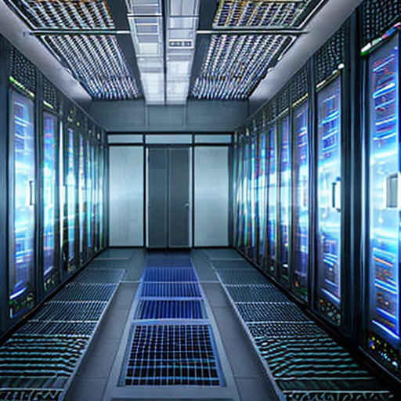
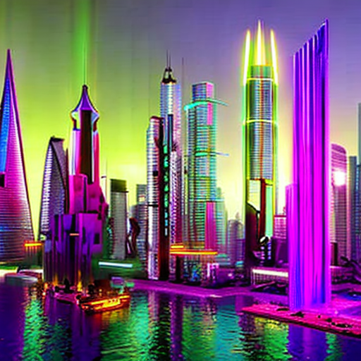
Basic Concept
Maintained by a development and management team, this platform allows for the provision of knowledge base and system requirements to "The Agents' Domain." It uses a Universal Application Description Language (UADL) for software generation and updates.
VIEW MORE

Slide 8
Theoretical Foundation: System Dimensions
Zeroth Dimension - Ethical Dimension The founders define the basic ethical standards of the system.
First Dimension - Educational Dimension Responsible for providing the basic knowledge and standard systems required by other dimensions (including proposals, architecture, design, development, testing, operations, management, industry, etc., covering various types of textbooks and standards).
Second Dimension - Management Dimension Various management personnel are responsible for project management (involving 18 types of management instructions, following management standards to carry out management tasks in various fields).
Third Dimension - Technical Dimension Various technical personnel are responsible for project implementation (including design, development, testing, operations, and other instructions, following related standards and templates to execute tasks under management supervision).
Fourth Dimension - Industry Dimension Programs are automatically generated, including project management systems, medical expert systems, etc. (Industry role instructions carry out industry tasks and are subject to management supervision).

Slide 9
03
Software Generation and Management Platform
Software Generate and Management Platform

Slide 10

Basic Concept
System code generation will be based on automatically evolving agents, with reference code from metagpt and swarm. The foundational agents consist of five system-level advanced agents, ten development standards, eighteen management standards, and fifty cases (proposals, architecture, operations, etc.), as well as over one hundred and seventy IT knowledge tutorials, and an even greater number of professional knowledge standards and tutorials. This will all be completed using professional system code generation templates based on jhipster and pyhipster. We are in an era of coexistence between humans and machines, where both learn and collaborate with each other. There is also an expert platform.

Slide 11
Theory Basic
The human-machine interface is achieved by defining a Universal Application Description Language (UADL), which includes:
Entity and Relationship Description
Business Process Description
Interface Description
Database Description
User Permission Description
User Interface Description
Business Logic Description
System Architecture Description
System Release Description
The domain of agents is responsible for generating UADL. Systems composed by jhipster and pyhipster are responsible for generating industry application systems. pjhipster, which interfaces with activepieces, is responsible for process and interface control and is renamed as pjflow.

Slide 12
04
Customer Application Platform
Customer Application Platform.

Slide 13
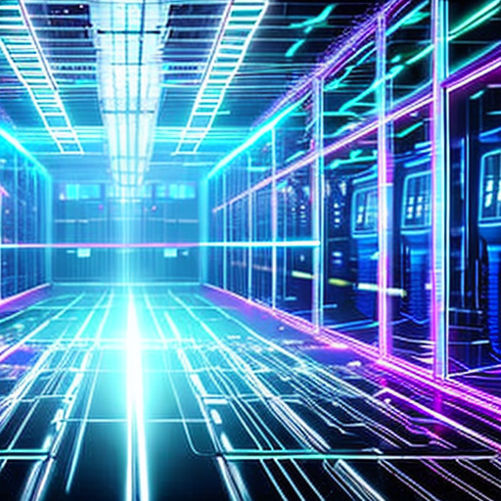
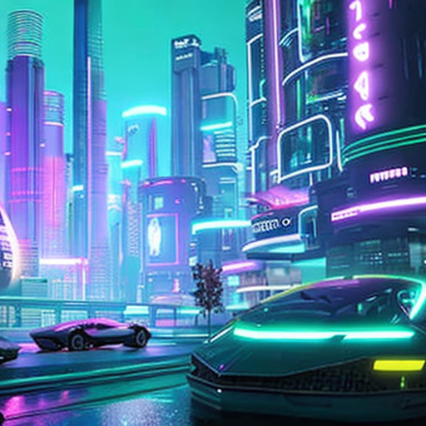
Construct of Customer Platform
Project Management Platform: Responsible for managing progress information, with the domain of agents assessing the situation and risks. Communication between the project management platform and the domain of agents is defined by a common project description language.
Holographic Medical Platform: Handles patient information entry and clinical examination data entry. The domain of agents is responsible for assessing the patient's condition and providing next-step recommendations. The communication between the holographic medical platform and the domain of agents is defined by a common language for describing conditions and treatments.
Sales Management Platform: In charge of customer and product information entry and management, while the domain of agents is responsible for promotion. Supports a common product and customer description language.
Asset Management Platform: Manages asset entry and transactions, with the domain of agents responsible for asset evaluation. Supports a common asset description language.
Advertising Promotion Platform: This platform manages advertising content, with the domain of agents optimizing descriptions, selecting regions, email marketing, etc. Supports a common advertising description language.
Talent Management Platform: Responsible for talent information entry, with the domain of agents assessing suitable positions, pricing, and training content. Supports a common talent description language.
Film and Television Production Platform: The domain of agents generates scripts, and this platform is responsible for film and television production. Supports a common video description language. Includes an expert platform.

Slide 14
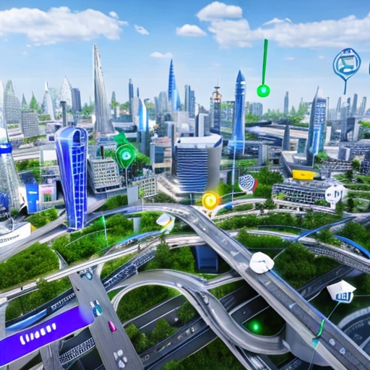

Relationship of Customer Platform
There can be complex associations between the various platforms, which help to enhance the survivability of the system. The advertising platform can request the film and television platform to take charge of video production, and conversely, the film and television platform can ask the advertising platform for specific promotions. The sales management platform can ask the advertising platform for promotion, while also providing customer information to the advertising platform. The project management platform can interact with the talent management platform, and it can also use the advertising platform to recruit talent and funds. The holographic medical platform can also be promoted through advertising, and patients can be potential advertising clients. Talent information can be advertised on the advertising platform for job searches, making them also potential advertising clients. Asset management can request the advertising platform to promote managed assets, and the users of the asset management system can also be potential advertising clients.

Slide 15
05
User Management Platform
User security and permission management.

Slide 16
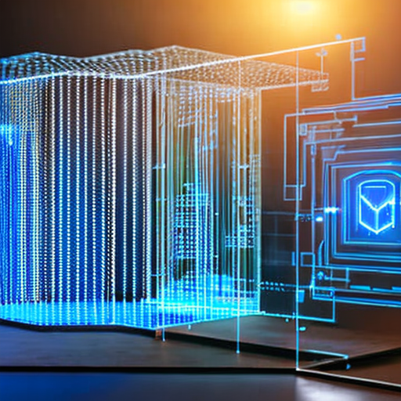
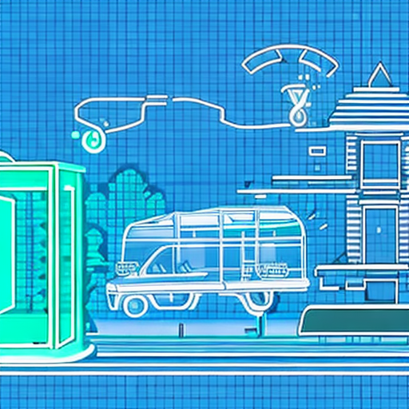
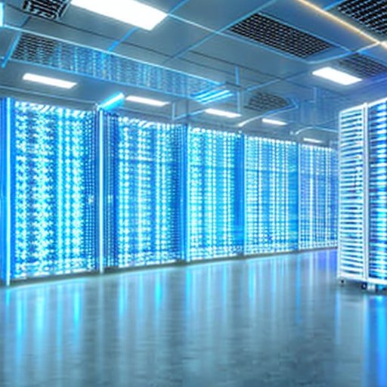
System Feature
Manages login information and collaboration, providing role-based user management and supporting various authentication methods.

Slide 17
06
Workflow Management Platform
Workflow Management Platform.

Slide 18
System Feature
Serves as an interface between the core platform, GPTs platform, and other platforms, facilitating communication and process control.

Slide 19
07
Payment Management Platform
Payment Managment Platform.

Slide 20
Payment Managenet
Payment Integration
Integrates various payment methods including major credit cards, Chinese payment platforms like UnionPay, Alipay, WeChat, and others like PayPal, to support transactions across different platforms.

Slide 21
08
Portal Website of The Agents' Domain
Door Platform for The Agents’Domain.

Slide 22

Web Contents
Education District: edu.ujhb.org
Displays educational materials from the domain of agents.
Agents' District
Showcases the GPTs of the domain of agents.
Film and Television District: YouTube
Exhibits film and television works, video collections, advertisements, etc., from the domain of agents.
Application Park: park.highwayns.com
Overview of applications from the domain of agents, including holographic medicine, project manors, etc.
Social District
Overview of social media from the domain of agents, with all groups marked by the domain of agents.

Slide 23
09
Application management System
Application management System.

Slide 24
Application management System
api-gateway
Config server
Discover server
Highwayai
Highwaymq
Login server

Slide 25
10
Reference System
Reference System.

Slide 26
Reference System
Kanboard
erpnext
RealEstateCRM
Revive-adserver
Canvas LMS
Odoo

Slide 27
11
Analysis System and Algorithm
Analysis System and Algorithm

Slide 28
Analysis System and Algorithm
ADSwarm
BookWriter
FintectSwarm
GameSwarm
HRSwarm
Medical Intake
SDSwarm
SalesSwarm
SongWriter
VideoCreator

Slide 29
The Agents' Domain (AI Comprehensive Application Platform)
Reporter：SOB
2024.02.17

